Slide 1
Tournament Generator Start your own Tournament now!
Information System Development
Presentation group project
Alexander Büchel, Fabio Hilti, Lucy Gannon

Slide 2

Agenda
Project Group & Project Aim
Project Description
Live Demonstration
Code Quality
Challenges
Highlights
Version Control
Notes:
Functionality (with live demonstration) (Fabio)
Documentation (flow chart, description, project aim) (FABIO)
Challenges (what went well, what not) (LUCY)
Code quality (screenshots from phyton) (LUCY)
What are we proud of (ALEX)
Show version control? (Screenshots or GitHub?) (ALEX)

Slide 3

Project Group & Project Aim
Project Group
Alexander, Fabio & Lucy
Little to no experience in Phyton/Django
No Coding-Background
Project Aim
Creative and functional web project
Greater Understanding coding
Tournament Generator

Slide 4
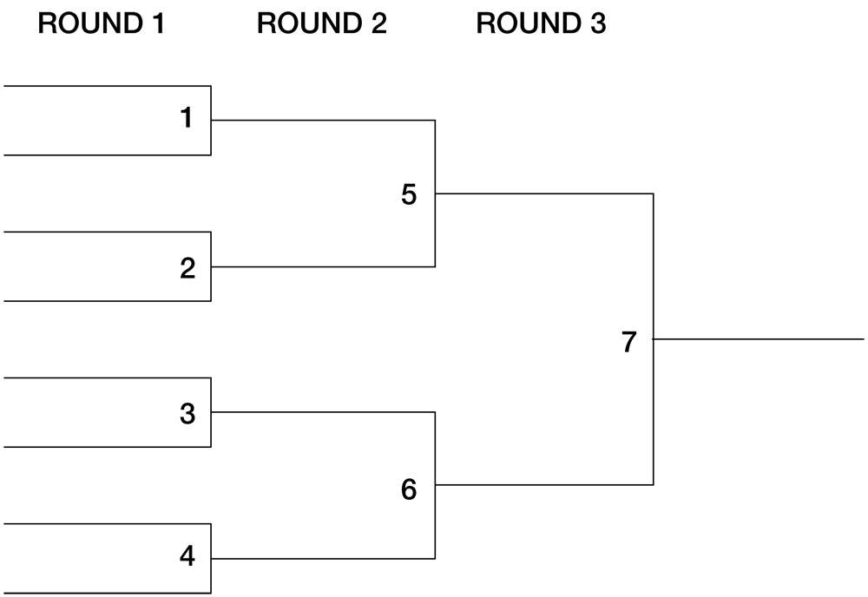
Project Description
Our Choice: Tournament Generator
Sport Competition or Fun
Creation of Tournament Brackets
Size for 8, 16 or 32 Teams
Creation of individual teams
Easy to use & understand for end-user
Notes:
Source Picture:
https://www.baggo.com/templates/default/images/bracket.png

Slide 5

Live Demonstration

Slide 6
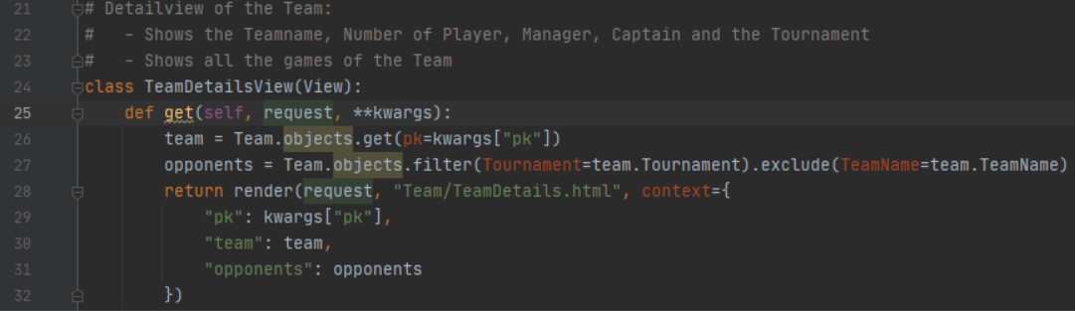
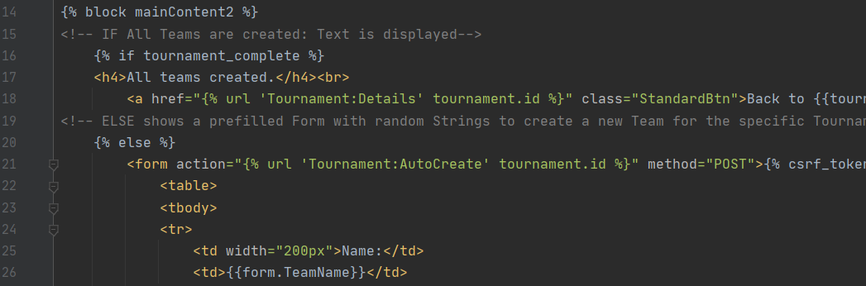
Code Quality

Slide 7

Challenges
Successes
Fulfilled all the major requirements of all stakeholders
Pleasant and Intuitive Design
Quality Code
Challenges
Communication
Differences in skill
Challenge of the Tournament Tree

Slide 8

Highlights
Tournament Tree
Autofill
Achievements:
Nice project with no experience
Almost all requirements fulfilled

Slide 9

Version Control
https://github.com/BuecAle/TournamentGenerator_ISD/
Notes:
Image source:
https://pngimg.com/uploads/github/github_PNG15.png

Slide 10

END OF
PRESENTATION

